Slide 1
National Pollutant Discharge Elimination System (NPDES) Combine Sewer Overflow Operational Plan
December 19, 2019

Slide 2
CSO Background
Combined sewer systems (CSSs) are wastewater collection systems designed to carry sanitary sewage (consisting of domestic, commercial, and industrial wastewater) and storm water (surface drainage from rainfall or snowmelt) in a single pipe to a treatment facility.
CSSs serve about 43 million people in approximately 1,100 communities nationwide.

Slide 3
CSO Background
Most of these communities are located in the Northeast and Great Lakes regions.
During dry weather, CSSs convey domestic, commercial, and industrial wastewater.
In periods of rainfall or snowmelt, total wastewater flows can exceed the capacity of the CSS and/or treatment facilities.

Slide 4
CSO Background
When this occurs, the CSS is designed to overflow directly to surface water bodies, such as lakes, rivers, estuaries, or coastal waters.
These overflows-called combined sewer overflows (CSOs)-can be a major source of water pollution in communities served by CSSs.

Slide 5
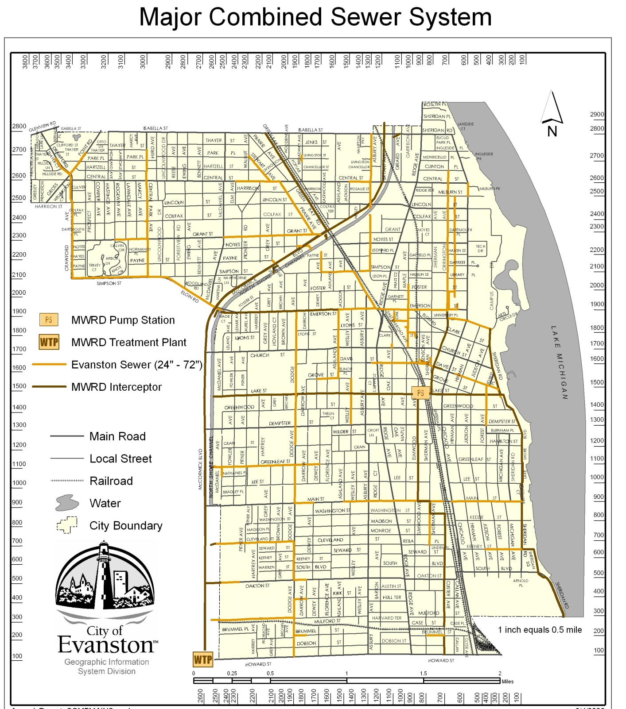
City operates 3 separate sewer systems
  Combined
    144 miles total
    100 miles is older than 100 years
  Combined Relief (Long Range Sewer Program)
  Storm Sewer System
Notes:
These sewers originally drained to Lake Michigan. Sanitary District of Chicago formed in 1889
Channel built 1907 – 1910
District interceptors constructed 1916 – 1920
Northside plant went into operation in 1928 (333 MGD)
Deep tunnel placed into service in 1980. Still waiting for reservoir

Slide 6
Evanston Combined Sewer System
The City of Evanston is within the service area of the Metropolitan Water Reclamation District of Greater Chicago (MWRD) and is served primarily by a combined sewer system (CSS).
The City of Evanston is not responsible for the treatment and disposal of its wastewaters, which are discharged into the MWRD North Side Interceptor sewer and the MWRD Tunnel and Reservoir Plan (TARP) deep tunnel system.

Slide 7
Evanston Combined Sewer System
Since Evanston is so reliant on the MWRD regional system, CSO events are closely related to rainfall in the entire MWRD drainage basin, and not to rainfall in the local Evanston area only.
The City of Evanston combined sewer system consists of an older combined sewer system and a recently constructed system of relief-combined sewers (constructed between 1991 and 2008).

Slide 8
Evanston Combined Sewer System
The combined sewer system is approximately 100 years old and is undersized by current standards. The relief sewer system relieves the system by providing additional hydraulic capacity.
The relief-combined sewers are designed to supplement the limited capacity of the original combined sewer system and in conjunction with the installation of catch basin flow restrictors, eliminate basement back up in the City of Evanston.
Notes:
The NMC are as follows: 1. Proper operation and regular maintenance programs for the sewer system and CSO outfalls 2. Maximum use of the collection system for storage 3. Review and modification of pretreatment requirements to ensure that CSO impacts are minimized 4. Maximization of flow to the POTW for treatment 5. Elimination of CSOs during dry weather 6. Control of solid and floatable materials in CSOs 7. Pollution prevention programs to reduce containments in CSOs 8. Public notification to ensure that the public receives adequate notification of CSO occurrences and CSO impacts 9. Monitoring to effectively characterize CSO impacts and the efficacy of CSO controls.

Slide 9
Evanston Combined Sewer System
The older combined sewer system consists of a series of street sewers and trunk sewers that are sub divided into fifteen (15) drainage basins. Each of the combined sewer system basins includes a separate trunk sewer and an independent connection to the MWRD facilities. Twelve (12) out of the fifteen (15) drainage basins discharge directly to the TARP tunnel system through drop shafts. The remaining three (3) systems discharge indirectly to TARP through the MWRD interceptor sewer system.

Slide 10
Administrative Controls
The City of Evanston has adopted and administrated the following ordinances and regulations in order to enforce the City’s CSO and pollution control strategies:
  City Evanston Sewer Use Ordinance
  MWRD Ordinance
  City of Evanston Plumbing Code

Slide 11
Administrative Controls
The City of Evanston is using a computer database system to maintain physical data on its sewer collection system and to keep an inventory of all other activities, including sewer system operational and maintenance activities.

Slide 12
Operational & Maintenance Programs
The Water Production Bureau of the Public Works Agency has the overall responsibilities to oversee the Operational and Maintenance (O&M) programs for the City of Evanston.
Routine sewer system maintenance tasks are carried out by designated staff from the Sewer Section and are closely supervised by crew chiefs and/or the Sewer Supervisor.
Funding for the sewer system O&M as well as capital project is available from the Sewer Fund. This is an Enterprise Fund with revenues generated by a sewer service charge ($3.39/100 cu.ft.).

Slide 13
Operational & Maintenance Programs
The Evanston O&M programs were specifically designed to ensure that its CSS will function effectively, and will reduce the magnitude, frequency, and duration of CSOs to the minimum level. The current O&M programs are including the following:
  • Sewer Inspection/Rehabilitation Program
  • Sewer Cleaning/Flushing Program
  • Catch Basin Cleaning Program
  • Emergency Sewer Repairs Program
  • Regular Street Cleaning Program
Notes:
Sewer Inspection/Rehabilitation is performed annually (2.2 miles)
Sewer Cleaning/Flushing is carried out every year in one of the four areas
Catch Basin Cleaning is performed once every three years.
Regular Street Cleaning is performed annual (March 1 – December 15)

Slide 14
Pollution Notification Plan
Evanston’s CSO public notification plan is completed in conjunction with the MWRD since the occurrence of CSOs is directly impacted by the operation of the MWRD sewer system.
The MWRD has created a web page on their website to inform the general public of the occurrence of CSOs on the Chicago Area Waterways (CAWS).

Slide 15
Pollution Notification Plan
A Geographic Information System (GIS) based map of the waterways appears on the web page depicting the occurrence of CSOs and waterway diversions to Lake Michigan.
This map is updated on a daily basis based on information received from the control structures seven days per week. The North Shore Channel through Evanston is depicted on the map. Upon occurrence of a CSO along the Channel, a point on the map will designate the location of that CSO discharge.

Slide 16
Pollution Notification Plan
The MWRD monitors CSO discharges at seven (7) locations in Evanston. Five (5) of these locations are at CSO outfalls owned by Evanston and two (2) are owned by the MWRD.

Slide 17
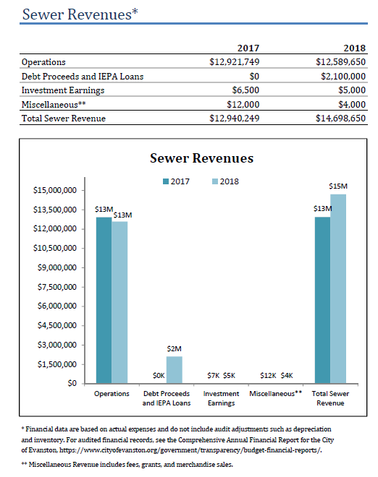
Annual Report

Slide 18
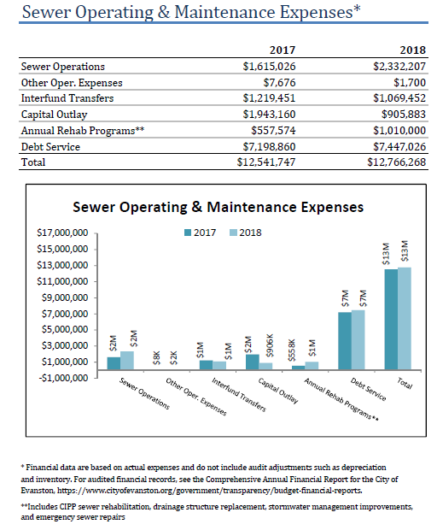
Annual Report

Slide 19
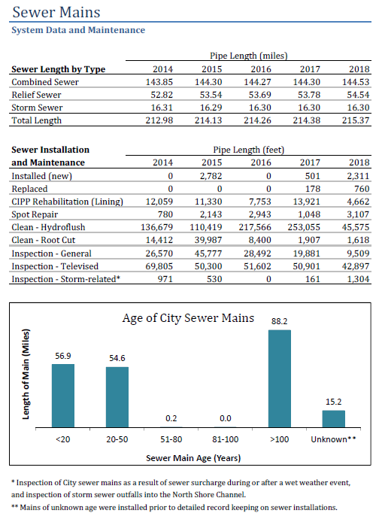
Annual Report

Slide 20
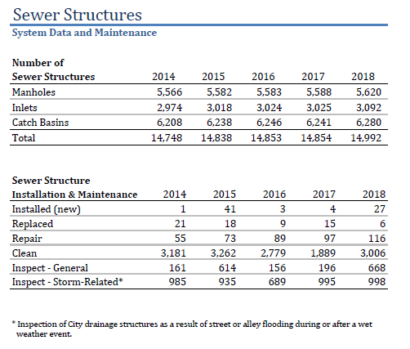
Annual Report

Slide 21
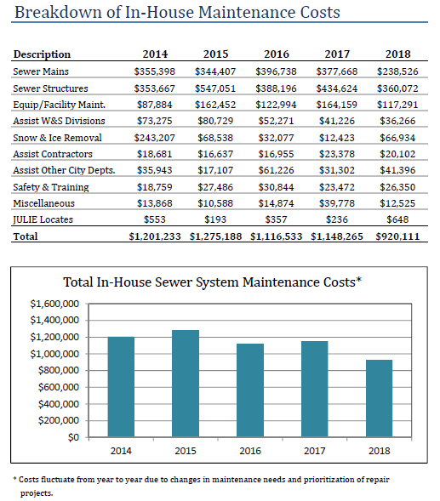
Annual Report

Slide 22
Contact Information
Darrell A. King
Water Production Bureau Chief
Public Works Agency
dking@cityofevanston.org
847-448-4311

Slide 23
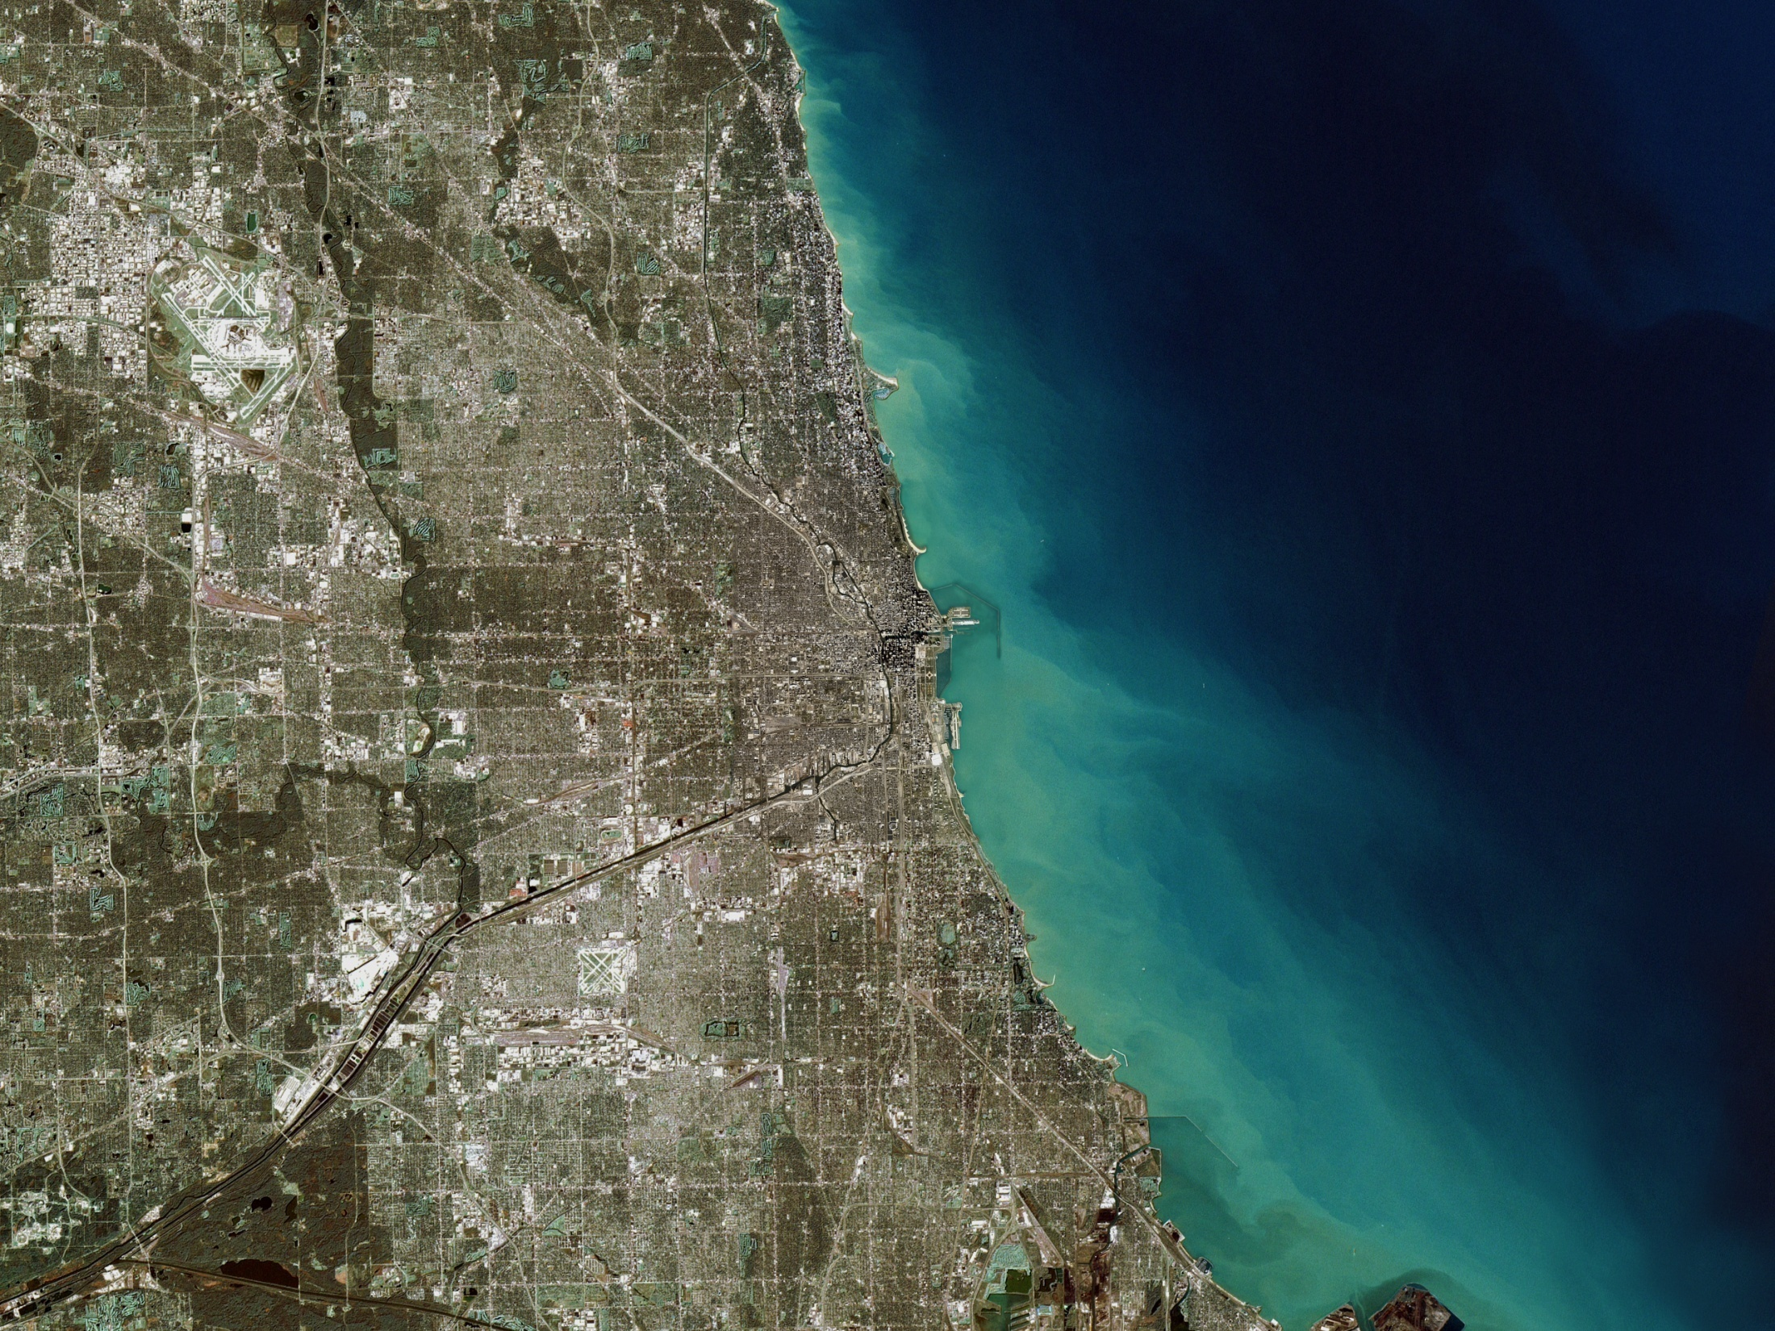
QUESTIONS?

